Slide 1
The Laws related to Sale of Goods
Definition of ‘goods’ and ‘sale’
Essentials of a sale
Difference between ‘contract of sale’ and ‘agreement to sell’
Caveat Emptor
Conditions and Warranties
Nemo Dat quod non habet and its exceptions
Unpaid Seller Rights

Slide 2
Sale of Goods Act is one of very old mercantile law.
Sale of Goods is one of the special types of Contract.
Initially, this was part of Indian Contract Act itself in chapter VII (sections 76 to 123).
Later these sections in Contract Act were deleted, and separate Sale of Goods Act was passed in 1930.
The Sale of Goods Act is complimentary to Contract Act. Basic provisions of Contract Act apply to contract of Sale of Goods also.

Slide 3
Contract of Sale Definition
“A contract of sale of goods is a contract whereby the seller transfers or agrees to transfer the property in goods to the buyer for a price.”
There may be a contract of sale between one part-owner and another. [section 4(1)].
A contract of sale may be absolute or conditional. [section 4(2)].

Slide 4
Basic requirements of contract
i.e. offer and acceptance,
legally enforceable agreement,
mutual consent,
parties competent to contract,
free consent,
lawful object, consideration etc. apply to contract of Sale of Goods also
Thus, following are essentials of contract of sale –
It is contract, i.e. all requirements of ‘contract’ must be fulfilled
It is of ‘goods’
Transfer of property is required
Contract is between buyer and seller
Sale should be for ‘price’
A part owner can sale his part to another part-owner
Contract may be absolute or conditional.

Slide 5
Sale and Agreement to Sell distinguished
Where under a contract of sale the property in the goods is transferred from the seller to the buyer, the contract is called a sale,
but where the transfer of the property in the goods is to take place at a future time or subject to some condition thereafter to be fulfilled, the contract is called an agreement to sell [section 4(3)].
An agreement to sell becomes a sale when the time elapses or the conditions are fulfilled subject to which the property in the goods is to be transferred [section 4(4)].
The provision that contract of sale includes agreement to sell is only for the purposes of rights and liabilities under Sale of Goods Act and not to determine liability of sales tax, which arises only when actual sale takes place.

Slide 6
Goods
Goods - “Goods” means every kind of movable property other than actionable claims and money; and includes stock and shares, growing crops, grass, and things attached to or forming part of the land which are agreed to be severed before sale or under the contract of sale. [section 2(7)].
Actionable claims – things which a person cannot make use of, but which can be claimed by him by means of a legal action. Ex: Debt
Money – is also a legal tender. Cannot be sold and purchased as goods. But old coins and foreign currencies can be bought and sold so are goods.

Slide 7
Classification of goods
Existing – is available readily for sale
Future / Contingent – will be made available Ex: crops

Slide 8
Price
“Price” means the money consideration for a sale of goods. [section 2(10)].
Consideration is required for any contract.
However, in case of contract of sale of goods, the consideration should be ‘price’ i.e. money consideration.

Slide 9
How Contract of sale is made –
A contract of sale is made by an offer to buy or sell goods for a price and the acceptance of such offer.
The contract may provide for the immediate delivery of the goods or immediate payment of the price or both, or for the delivery or payment by instalments, or that the delivery or payment or both shall be postponed [section 5(1)].
Subject to the provisions of any law for the time being in force, a contract of sale may be made in writing or by word of mouth, or partly in writing and partly by word of mouth or may be implied from the conduct of the parties [section 5(2)].
Thus, credit sale is also a ‘sale’. - - A verbal contract or contract by conduct of parties is valid. e.g. putting goods in basket in super market or taking food in a hotel.

Slide 10
Two parties to contract –
Two parties are required for contract. - - “Buyer” means a person who buys or agrees to buy goods. [section 2(1)].
“Seller” means a person who sells or agrees to sell goods. [section 2(13)].
A part owner can sell his part to another part-owner.
However, if joint owners distribute property among themselves as per mutual agreement, it is not ‘sale’ as there are no two parties

Slide 11
Transfer of property -
“Property” means the general property in goods, and not merely a special property [section 2(11)].
In layman’s terms ‘property’ means ‘ownership’.
‘General Property’ means ‘full ownership’.
Thus, transfer of ‘general property’ is required to constitute a sale.
If goods are given for hire, lease, hire purchase or pledge, ‘general property’ is not transferred and hence it is not a ‘sale’.

Slide 12
POSSESSION AND PROPERTY –
Note that ‘property’ and ‘possession’ are not synonymous.
Transfer of possession does not mean transfer of property. e.g. - if goods are handed over to transporter or godown keeper, possession is transferred but ‘property’ remains with owner.
Similarly, if goods remain in possession of seller after sale transaction is over, the ‘possession’ is with seller, but ‘property’ is with buyer.

Slide 13
Ascertainment of price –
The price in a contract of sale may be fixed by the contract or may be left to be fixed in manner thereby agreed or may be determined by the course of dealing between the parties. [section 9(1)].
Where the price is not determined in accordance with the foregoing provisions, the buyer shall pay the seller a reasonable price.
What is a reasonable price is a question of fact dependent on the circumstances of each particular case. [section 9(2)].

Slide 14
Difference
Sale: An executed contract
Since the property is passed on to buyer, the seller can sue the buyer for the price
Creates a right in rem
In case of loss of goods, the loss will fall on the buyer, even though the goods are in the possession of the seller. Because ‘risk’ is associated with ownership
In case the buyer pays the price and the seller becomes insolvent, the buyer can claim the goods from the Official Receiver or Assignee
If the buyer becomes an insolvent without paying the price, the ownership having passed to the buyer, the seller shall have to deliver the goods to the Official Assignee or Receiver, except where he has lien over the goods
Agreement to Sell: An executory contract
In case of breach, the seller can only sue for damages, unless the price was payable at a stated date
Creates a right in personam
The loss in this case shall be borne by the seller, even though the goods are in the possession of the buyer
The buyer cannot claim the goods but only a rateable dividend for the money is paid
The seller can refuse to deliver the goods to the Official Assignee or Receiver

Slide 15
CAVEAT EMPTOR

Slide 16
LET THE BUYER BEWARE
the buyer could not recover from the seller for defects on the property that rendered the property unfit for ordinary purposes.
The only exception:
if the seller actively concealed latent defects or otherwise made material misrepresentations amounting to fraud

Slide 17
modern trend
IS
the Implied Warranty of Fitness that applies only to the sale of new residential housing by a builder-seller and the caveat emptor rule applies to all other sale situations (i.e. homeowner to buyer).

Slide 18
EARLIER
the buyer had no warranty of the quality of goods.
In many jurisdictions now, the law requires that goods must be of "merchantable quality".
However, this implied warranty can be difficult to enforce and may not apply to all products. Hence, buyers are still advised to be cautious.

Slide 19
In addition to the quality of the merchandise, this phrase also applies to the return policy.
In most jurisdictions, there is no legal requirement for the vendor to provide a refund or exchange.
In many cases, the vendor will not provide a refund but will provide a credit.
In the cases of software, movies and other copyrighted material many vendors will only do a direct exchange for another copy of the exact same title.
Most stores require proof of purchase and impose time limits on exchanges or refunds.
However, some larger chain stores will do exchanges or refunds at any time, with or without proof of purchase, although they usually require a form of picture ID and place quantity or dollar limitations on such returns.

Slide 20
CAVEAT VENDITOR
Let the seller beware
It is a counter to caveat emptor and suggests that sellers can also be deceived in a market transaction.
This forces the seller to take responsibility for the product and discourages sellers from selling products of unreasonable quality

Slide 21
CONDITIONS AND WARRANTIES

Slide 22
CONDITION
is a term [oral/written] which goes directly to the root of the contract,
or
is so essential to its very nature that if it is broken the innocent party can treat the contract as discharged.
that party will not therefore be bound to do anything further under that contract

Slide 23
WARRANTY
it is a term of the contract which is collateral or subsidiary to the main purpose of the contract.
it is therefore not so vital as to affect a discharge of the contract
a breach of warranty only entitles the innocent party to an action for damages, he cannot treat the contract as discharged.

Slide 24
Example
A man buys a particular horse, which is warranted quiet to ride and drive. If the horse turns out to be vicious, the buyer’s only remedy is to claim damages.
But if instead of buying a particular horse, a man asks a dealer to supply him with a quiet horse and the horse turns out to be vicious, the stipulation is a condition and the buyer can reject the horse, or keep the horse and claim damages.

Slide 25
POUSSARD v SPIERS & POND
P was an opera singer. She agreed to sing in an opera starting on 28th Nov. However she became ill and was unable to sing until 4th Dec.
The opera company had to hire another singer so that the opera could start on 28th Nov
They could only get another singer if they hired her for all the performances of the opera
They did this and refused the services of Mrs. P once she was better
P raised a court action to try to make the company pay her
However the court said – P breached a condition of the contract when she was unable to perform on 28th Nov
This was a basic term of the contract

Slide 26
BETTINI v GYE
The position was different
B was an opera singer
He agreed to sing in London in a number of theatres beginning on 30th March
He also agreed that he would arrive in London 6 days before the first performance in order to practice
B became ill and did not arrive in London until 3 days before the first performance

Slide 27
The opera company refused to allow him to sing
They said he had breached the contract
However the court said that the part of the agreement about practicing was a warranty not a term
That meant it was not a basic part of the contract.
It was subsidiary part

Slide 28
TYPES OF CONDITIONS AND WARRANTIES
Express
Which are expressly provided in the contract
Implied
Which the law implies into the contract unless the parties stipulate to the contrary

Slide 29
The Monopolies and Restrictive Trade Practices Act (and the Fair Trading Act) now Competition Act, 2002, build automatic conditions and warranties into all contracts for the sale of goods to consumers.
These conditions and warranties are 'implied' into the contract, which means you can assume that they will apply in addition to any express conditions and warranties agreed to as part of the contract.
However, they only apply to the supply of goods or services to ‘consumers’.

Slide 30
The following are Implied Conditions
Condition as to title –
1.a. Seller only has the right to sell. If the title turns out to be defective, the buyer is entitled to reject the goods and claim refund of the price (if paid) plus damages. This will be allowed even where the buyer has used the goods.
1.b. Where the goods are sold by infringing a trademark, the buyer has the right to repudiate the transaction on the ground that there was a breach of condition as to title.

Slide 31
Trademark infringement
Section 29 of the Trademark Act states that when a registered trade mark is used by a person who is not entitled to use such a trade mark under the law, it constitutes infringement. A registered trade mark is infringed, if:-
1. The mark is identical and is used in respect of similar goods or services or
2. The mark is similar to the registered trade mark and there is an identity or similarity of the goods or services covered by the trade mark
3. And Such use is likely to cause confusion on the part of the public or is likely to be taken to have association with the registered trade mark.
For example, if you are not the Nike® company or authorized by it, it is
an infringement to sell sports clothes called “Nikestuff”

Slide 32
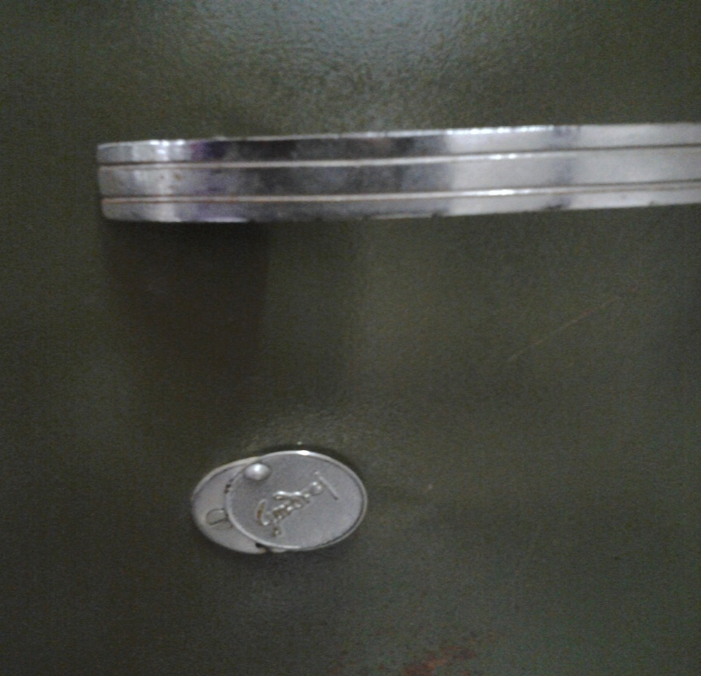
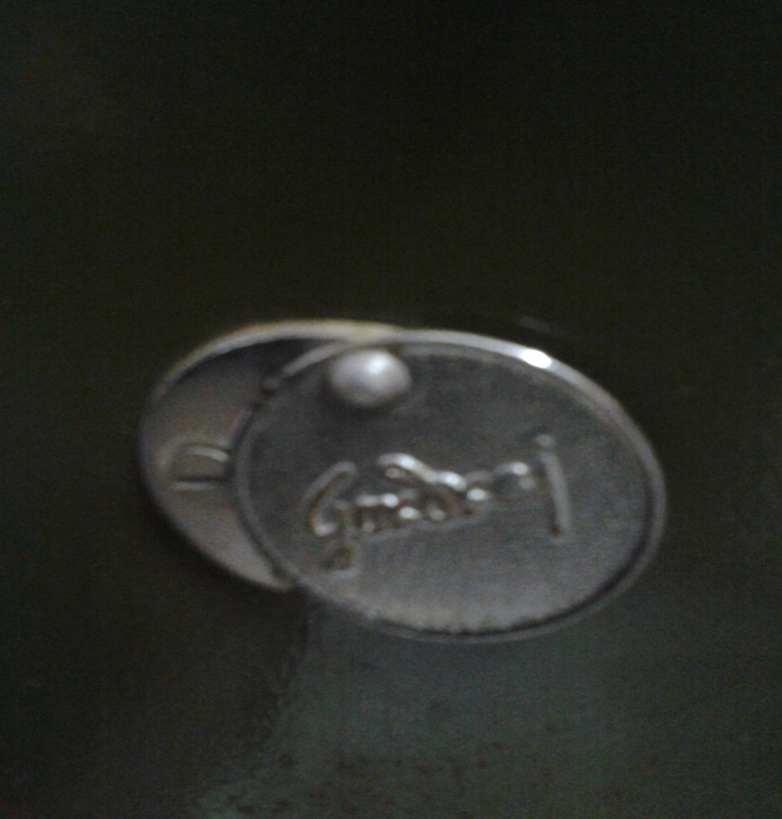
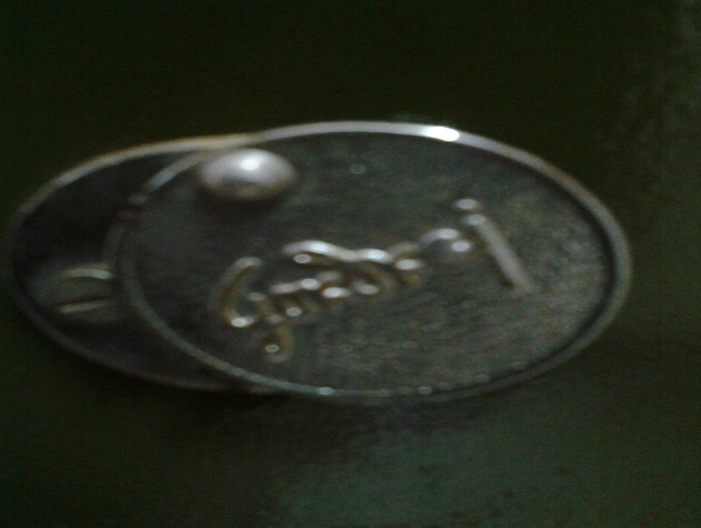
INFRINGEMENT
An example of
passing off ones goods as another
and diluting the company's trademark.

Slide 33
Raymond textiles and Raymond Pharmaceuticals
http://articles.economictimes.indiatimes.com/2010-07-19/news/27572894_1_trademark-act-infringement-raymond-limited

Slide 34
Decision
Both companies deal with dissimilar goods and services.
Also, the pharmaceutical company was only using "Raymond" as a business name and not as a trademark to promote its goods and services

Slide 35
Tata & oktatabyebye.com
A case on domain name dispute
Tata sons Ltd v.oktatabyebye.com

Slide 36
Tata Sons Limited under the Indian Companies Act, 1913 having its registered office at Bombay House, 24, Homi Mody Street, Mumbai – 400 001, India.
TATA Group of companies-India’s oldest, largest and best-known conglomerate, with a turnover that is over USD 62 Billion. Total turnover for 2007-08 is stated to be Rs.251,543 crores (USD 62.5 billion).

Slide 37
MakeMyTrip.com - Gurgoan based travel company that in a span of 8 years has garnered a wealth of experience and respect in the travel industry.
The pioneers of online travel services in India; leading travel website in the country, with over 2 million unique visitors each month choosing to use our travel services.
MAKE MY TRIP . COM
TO
OK TATA BYE BYE .COM
Three years after MakeMyTrip.com launched an online travel community and called it OkTataByeBye.com

Slide 38
Issue arise ‘ TATA’ is a well-known famous and registered trademark and service mark over which Tata, being the registered proprietor had statutory rights as well as common law rights by virtue of a long and continuous use.
scope for confusion in the minds of relevant group of consumers . The use of the word ‘tata’ in the first part of the domain name could lead to consumers assuming it to be a site maintained by Tata
MakeMyTrip did not establish “any demonstrable preparation to use the disputed domain name in connection with a bona fide offering of goods or services” when it already had a site makemytrip.com in connection with its business

Slide 39
Different view in Bosley case – the same in India
Kremer was unhappy about hair restoration treatment given by the Bosley Medical Institute (www.bosley.com is registered trademark)
Kremer registered two domains
www.bosleymedical.com
www.bosleymedicalviolations.com
Started to outline his grievances

Slide 40
Bosley sued, the trial court dismissed
Appellate court allowed the appeal on the question by the Institute on cybersquatting
Whether Kremer had a ‘bad faith intent to profit’ from the use of trade mark in his domain name
The court observed and held:
Non commercial use of a trade mark as the domain name does not constitute infringement
TM does not confer a right to prohibit the use of the word or words
It is not a copyright
A TM only gives the right to prohibit the use of it so far as to protect the owner’s good will against the sale of another’s product as his
When a mark is used in a way that does not deceive the public we see no such sanctity in the word as to prevent its being used to tell the truth

Slide 41
Legal remedies under Indian Trademarks Act-
Injunction, damages, delivery up of infringing goods, destroying infringing goods and material, etc.

Slide 42
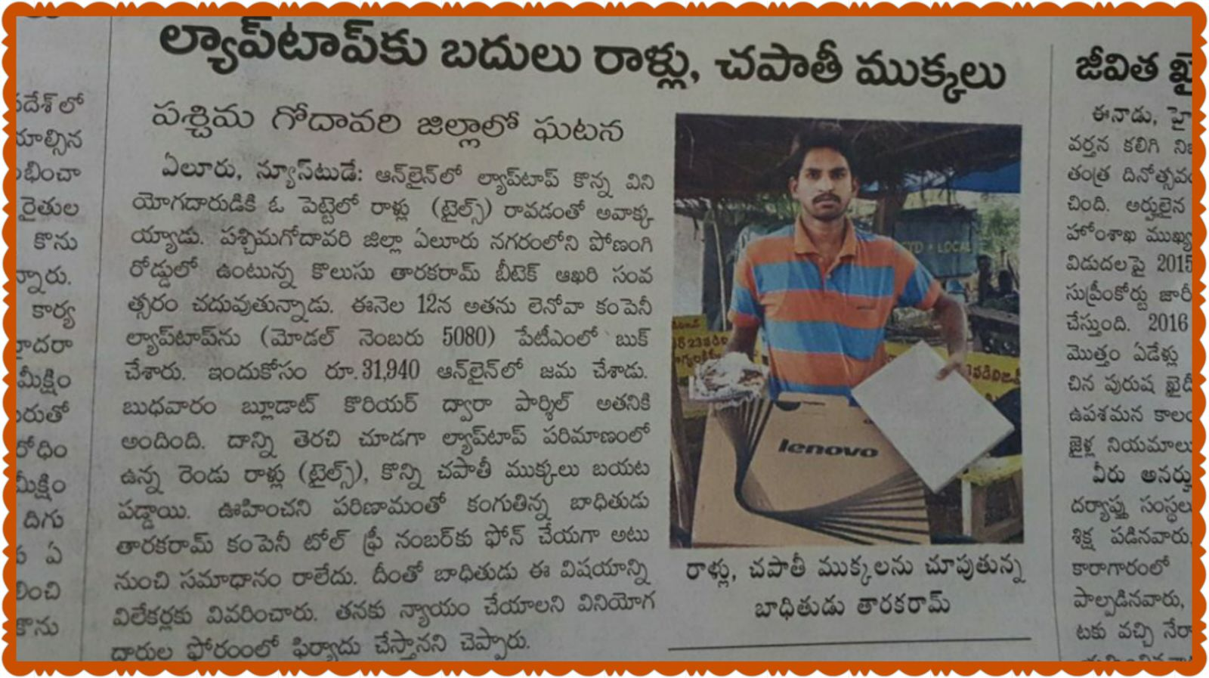
Sale by description –
Goods shall correspond with the description (it should be rice-rice, oil-oil) (it should not be rice-oil, nuts-fruits)
Ex: A box describing pens should not contain any other stationary other that pens described

Slide 43
3. Condition as to quality or fitness / Condition as to merchantability (if defected then replace or rectify. In case of damage suffered, it needs to be compensated)
– General rule is Caveat Emptor, but there are certain exceptions where caveat emptor does not apply and makes the seller liable:
3.1. The buyer makes known to the seller the particular purpose for which the goods are required so as to show that the buyer relies on the seller’s skill or judgment, and the goods are of a description which is in the course of the seller’s business to supply.
Ex: A person was a draper and had no special knowledge of hot water bottles, purchased a hot water bottle from a chemist. The bottle burst and injured his wife. It was held that as a breach of condition as to fitness and the chemist was made liable.

Slide 44
4. Sale by sample –
Bulk goods sold must correspond with that of the sample.
Reasonable opportunity of comparing the bulk with the sample.
No latent defects but, known only at later use.
5. Conditions as to wholesomeness-
in case of edibles, it must be fit for human consumption.
Ex: in case of food articles, there is an implied condition that the article is fit for human consumption. Supplied milk contained typhoid germs, and the person consumed it died. (ex: contaminated)

Slide 45
The following are Implied Warranty
Warranty of quiet possession (the right of enjoyment or possession of buyer should not be disturbed by anyone)
X sold a second hand radio to Y. Y got it repaired. Police seized saying it was a stolen one. Y can sue & claim from X.
Warranty of freedom from encumbrances
X borrowed 500 from Y & hypothecated his radio with Y as security. Later on X sold this radio to Z who bought in good faith. Here, Z can claim from X, as his possession is disturbed by Y having a charge.

Slide 46
Warranty as to quality of fitness by usage of trade
it is based on the usage of the consumer.
Warranty to disclose dangerous nature of goods
X purchased a tin of disinfectant powder which required to be opened with special care. X’s wife while opening the tin was injured as the powder flew into her eyes. Held, the seller was liable for the injury sustained by X’s wife because of breach of warranty.

Slide 47
The Trade Practices Act defines the word 'consumer', which states that a person is a consumer if they:
buy goods or services for personal, domestic or household use or consumption
and they:
do not acquire the goods for the purpose of re-supply; and
do not use the goods in a production or manufacturing process in trade or commerce.

Slide 48
Remedies available
Permits the criminal prosecution of companies as well as civil actions by consumers against unfair practices by companies that supply goods and services.
There is a range of remedies available to consumers:
obtain an injunction to prevent a company from breaching the Trade Practices Act (s. 80);
seek damages (s. 82); or
request a wide range of orders - including the varying of any part of a contract, the cancelling of all or any part of a contract and the requirement that the infringing company take certain action to make amends to a consumer, often by supplying replacement parts or items (s. 87).

Slide 49
Difference
Condition: is a stipulation in a contract which is essential to the main purpose of the contract
A breach of condition gives the aggrieved party a right to sue for damages as well as the right to repudiate the contract.
A breach of condition may be treated as a breach of warranty
Warranty: is a stipulation which is only collateral or subsidiary to the main purpose of the contract
A breach of warranty gives only the right to sue for damages. The contract cannot be repudiated
A breach of warranty cannot be treated as a breach of condition

Slide 50
Transfer of Title

Slide 51
Usually the sale of goods takes place between the buyer and either the owner of the goods or by his authorised agent.
However, there are some circumstances in which a seller may purport to sell goods which he does not have any right to sell.
In these circumstances the law has to decide which of two innocent parties to favour: the buyer or the original owner.
It is at this stage that the nemo dat quod non habet rule comes into play.
This topic will consider the operation of this rule and whether the exceptions to it offer an effective compromise to what would otherwise be a very harsh rule.

Slide 52
In a typical case involving the nemo dat rule the seller (who is not the owner) will have sold goods to an innocent third party and then will have disappeared or become insolvent so that the two parties may not be able to seek a remedy from him.
Either the owner or the third party must suffer loss, and the court will have to decide which, as Lord Justice Denning stated in Bishopsgate Motor Finance Corpn Ltd v Transport Brakes Ltd.
Because of the apparent harshness of the nemo dat rule, several exceptions to it were developed at common law and also have been added by statute. All of the exceptions will apply only in favour of a person who acquires the goods in good faith and without notice of the rights of the original owner.

Slide 53
Nemo Dat Quod Non Habet
The important principles:
Protection of property
No one can give a better title than he himself possesses.
Protection of commercial transactions
The person who takes in good faith and for value without notice should get a good title

Slide 54
Section 27 of Indian Sale of Goods Act
Sale by person, not the owner:
Subject to the provisions of this act and of any other law for the time being in force, where goods are sold by a person who is not the owner thereof and who does not sell them under the authority or with the consent of the owner, the buyer acquires no better title to the goods than the seller had.
(means the position of the buyer and seller is the same as far as the title of the goods is concerned)

Slide 55
Understanding with an example – the general rule: Greenwood v Bennett
The owner of a car ‘A’ delivered it to another ‘B’ for repairs. The latter carried out no repairs, but instead kept using the car until he crashed it.
He then sold the car in the damaged state to an innocent buyer ‘C’ for a nominal price.
The buyer ‘C’ got the car repaired at an expenditure of Rs 20,000.
What remedy will the actual owner ‘A’ and the buyer ‘C’ get here?

Slide 56
Answer:
The owner ‘A’ was held entitled to recover the car from him ‘C’ but by paying him Rs 20,000.
The buyer acquired no better title to the goods than the seller had. Both of them do not get title / ownership to the goods

Slide 57
Exceptions, where nemo dat does not apply
Estoppel
Sale by mercantile agent
Sale by joint owner
Sale by person in possession under voidable contract
Seller in possession after sale
Buyer in possession before sale

Slide 58
Exception 1. Estoppel
This means that if the owner of the goods so conducts himself, when another person deals as an owner with those goods, as to lead a third party to believe that the person dealing with the goods has authority to sell then the true owner is estopped by his conduct from impeaching the disposition made.
The estoppel can arise in situations
when the true owner by words or conduct willfully causes another to alter his position and to induce him to act on that behalf.
in situations where the true owner stands by negligently or culpably (wantedly) and allows another to contract on the faith and understanding as if the seller has the authority to sell, or is the owner or has apparent title to the goods

Slide 59
Exception 2. Sale by Mercantile Agent
The term mercantile agent is defined in both British and Indian law as “having in customary course of his business as such, agent authority, either to sell goods or to consign goods for the purpose of sale, or to buy goods, or to raise money on the security of goods”
Heyman v. Flewker
only includes persons whose employment corresponds to that of some kind of known commercial agent like an auctioneer or a broker
And not
a mere servant or caretaker, or one who has possession of goods for carriage, safe custody, or otherwise as an independent contracting party

Slide 60
Exception 3. Sale by one of joint owners
If one of several joint owners of goods has the sole possession of them by permission of the co-owners,
That property in the goods is transferred to any person who buys them of such joint owner in good faith and
has not at the time of the contract of sale notice that the seller has not authority to sell.

Slide 61
Exception 4. Sale by person in possession under voidable contract
When the seller of goods has obtained possession thereof under a contract voidable (no free consent) under section 19 or section 19A of the Indian Contract Act, 1872,
but the contract has not been rescinded at the time of the sale, the buyer acquires a good title to the goods, provided he buys them in good faith and without notice of the seller’s defect of title.

Slide 62
Exception 5. Seller in possession of goods even after sale
Where a person, having sold goods,
continues or is in possession of the goods or of the documents of title to the goods,
the delivery or transfer by that person or by a mercantile agent acting for him of the goods or documents of title under any sale, pledge or other disposition thereof
to any person receiving the same in good faith and without notice of the previous sale shall have the same effect as if
the person making the delivery or transfer were expressly authorised by the owner of the goods to make the same.

Slide 63
6. Buyer in possession before sale
Where a person, having bought or agreed to buy goods,
Obtains possession of the goods or the documents of title to the goods, with the consent of the seller,
the delivery or transfer by that person or by a mercantile agent acting for him,
of the goods or documents of title under any sale, pledge or other disposition thereof
to any person receiving the same in good faith,
without notice of any lien or other right of the original seller
in respect of the goods shall have effect as if such lien or right did not exist.

Slide 64
Rights of an Unpaid Seller

Slide 65
Who is an Unpaid Seller?
The whole of the price has not been paid or tendered.
A bill of exchange / negotiable instrument has been received, but it was dishonored.
Conditions to be fulfilled to be deemed as Unpaid Seller
He must be unpaid and price must be due.
He must have an immediate right of action for the price.
A bill of exchange / negotiable instrument was received but the same was dishonored.

Slide 66
Rights of Unpaid Seller
Against the Goods
Property in the goods has passed
Property in the goods has not passed
Against the Buyer Personally
Against the Buyer Personally
Lien
Stoppage in Transit
Re - Sale
Withholding Delivery
Stoppage in Transit
Suit for Price
Suit for Damages
Repudiation of Contract
Suit for Interest

Slide 67
Right of Lien
A lien is a right to retain possession of goods until payment of the price [Sec 46 (1)(a)]. It is available to the unpaid seller of the goods who is in possession of them where –
the goods have been sold without any stipulation as to credit.
The goods have been sold on credit, but the term of the credit has been expired.
The buyer becomes insolvent.

Slide 68
The lien depends on actual possession and not on title.
The possession of the goods by the seller must not expressly exclude the right of lien.
The lien can be exercised by the unpaid seller only for the price and not for any other charges (warehouse, dock, etc.)
Where an unpaid seller has made part delivery of the goods, he may exercise his right of lien on the remainder. He may refuse to deliver the remainder of goods until he is paid the full amount.

Slide 69
The unpaid seller of the goods, having a lien thereon, does not loose his lien by reason only that he has obtained a decree for the price of the goods.
Termination of Lien – The unpaid seller of goods looses his lien on the goods when:-
He delivers the goods to a carrier / other bailee for the purpose of transmission to the buyer, without reserving the right of the disposal of the goods.
The buyer or his agent lawfully obtains possession of the goods as buyer.
The unpaid seller waives his right on the goods. He may do this either Expressly or Impliedly.

Slide 70
Right of Stoppage in Transit
This is the right of stopping the goods in transit after the unpaid seller has dispatched the goods. He can repossess the goods and continue to do so until payment.
When Buyer becomes insolvent.
When goods are in transit.

Slide 71
When Transit Comes to an End?
If the buyer or his agent in that behalf obtains delivery of the goods before they arrive at the appointed destination.
If, after arrival of the goods at the appointed destination, the carrier acknowledges to the buyer or his agent that he holds the goods on his behalf.
Where the carrier wrongfully refuses to deliver the goods to the buyer or his agent.
Where part delivery of the goods has been made to the buyer of his agent, the remainder of the goods may be stopped in transit.

Slide 72
Difference between Right of Lien & Right of Stoppage in Transit
Right of Stoppage in Transit | Right of Lien
Right arises only the buyer is insolvent. | Right can be exercises even when the buyer is able to pay but does not pay.
Right can be exercised even when goods are in possession of middleman | Right can be exercised on goods which are in actual possession.
Right commences when the goods have left the possession of the seller and continues until buyer / agent receives it. | Right comes to an end when the right of lien is surrendered by the seller.
The right is to regain or resume possession. | The right is to retain possession.

Slide 73
Right of Re-Sale
The unpaid seller can resale the goods, where–
The goods are of perishable nature
He gives a notice to the buyer of his intention to resale the goods & the buyer does not within a reasonable time pay.
In case on resale there is a loss (sale price < contracted price) then the seller can claim the loss as damages for breach of contract. In case of profit he is not bound to pass it to buyer. But in case notice is not given, then the seller can not-
Recover any loss from sale of goods
Retain any surplus in case of sale of goods

Slide 74
Right of Withholding Delivery
Where the property in goods has not passed to the buyer, an unpaid seller has, in addition to his other remedies , a right to withholding delivery.
Right of Stoppage in Transit
This is the right of stopping the goods in transit after the unpaid seller has dispatched the goods. He can repossess the goods and continue to do so until payment.

Slide 75
Right against the Buyer Personally
Suit for Price – sue for price of goods.
Suit for Damages for non acceptance – sue for damages & charges arising due to non acceptance of goods by buyer.
Repudiation of Contract before due date – The seller may wait or sue for damages.
Suit for Interest – may charge interest on the price when it becomes due from such date as notified by the seller.

Slide 76
Remedies for Breach of Contract of Sale
Seller’s Suits | Buyer’s Suits
Suit for damages arising because of non acceptance of goods | Suit for damages arising because of non delivery of goods
Suit for price | Suit for breach of warranty
Suit for damages for repudiation of contract by the buyer before due date | Suit for damages for repudiation of contract by the seller before end date
Suit for Interest | Suit for Interest
 | Suit for specific performance

Slide 77
Auction Sales
A sale by auction is a public sale where different intending buyers try to outbid each other. The goods are ultimately sold to the highest bidder.
The auctioneer so sells the goods by auction is an agent of the seller/owner. His relation with the owner is governed by the general principles of the law relating to agency.

Slide 78
Rules of Auction Sales
Goods put up for sale in lots.
Completion of Sale.
Right of Seller to Bid.
Sale not notified subject to a right to bid.
Reserve Price
Use of pretended bidding
Knock out or agreement not to bid against each other.

